Slide 1
Unit 5
Designing the work place,
Inventory control, material handling and quality control.
Marketing functions, market segmentation, market research and channels of distribution,
Sales promotion and product pricing.

Slide 2
Designing the work place
A well-designed workstation is important for productive work
Each workstation should be designed to suit the needs of the individual worker (dependant upon height,reach, size, etc) and take into account the type of machine being used and the task being performed.
A well-organised workstation (and workplace), that is well-lit, free from chemical hazards and noise, and that minimises material handling, will improve efficiency and reduce worker fatigue.
Sometimes even minor ergonomic changes in the design of equipment, workstations or job tasks, that cost very little, can make significant improvements in worker comfort, health, safety and productivity.

Slide 3
In this section we will look at some of the key areas in workstation design including:
Workstation layout;
Sitting and chair design;
Standing work positions;
Hand tools and controls;
Lifting;
Job design.

Slide 4
Workstation layout;
When you consider that most workers sit at the same workstation to perform the same tasks on a daily basis, it makes sense to almost “personalize” the machine, chair etc or make it easy for such equipment to be adjusted to suit each worker.
If the workstation is poorly designed it can lead to:
• lower back injury;
• the development or aggravation of RSIs (Repetitive Strain Injuries)
• circulatory problems in the legs.

Slide 5
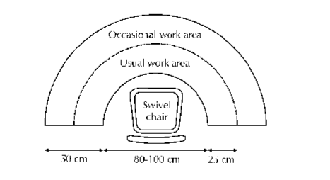

Slide 6
identify the tools that are used the most frequently;
place these most frequently used tools in the usual work area so that they can be reached without stretching;
tools such as nippers and scissors which are used frequently should be attached to the sewing machine or bench by cord – this minimizes the time spent searching. On no account should these tools be hung around the worker’s neck as is a common practice. The reason for this is that many of the machine parts are unguarded and any cord could get caught in the gear.
items such as pins can be kept in one place by using magnets attached to the case of a machine or a pin cushion. Other small accessories such as buttons, hooks, etc., can be kept in small, clearly labelled boxes within easy reach;
where possible, containers should be provided for material inputs and outputs, make sure the containers are not too deep and consider if they can be mobile for faster transport to the next operation.

Slide 7
Sitting and Chair Design
Lower back problems are on the increase as more workers sit at their workstations all day. Often, workers are provided with simple benches with no back rest.
A well-designed chair is essential – one that is adjustable for individual workers, for the height of the worktable and task, and that provides full lower back support.
The chair should allow workers to lean forward and backwards easily. The worker should have adequate leg room under the worktable so that he/she can change the position of the legs easily.
The feet should be flat on the floor or the worker should be provided with a footrest – this will eliminate pressure on the thighs and knees

Slide 8
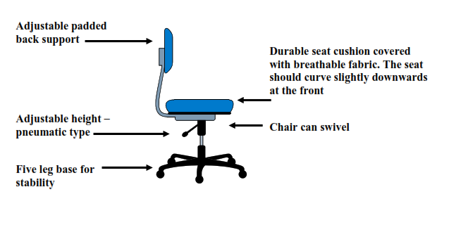

Slide 9
Standing Work Positions
Many garment workers stand all day at their workstation. Standing for long periods on hard concrete floors, often in bare feet, can cause back pain, sore feet and tired muscles. If a job must be done in a standing position, a chair or stool should be provided for the worker so that he/she can sit down at regular intervals.

Slide 10
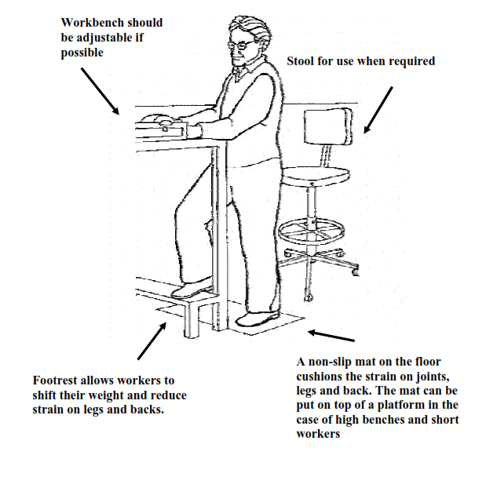

Slide 11
Hand Tools and Controls
Hand tools should be designed according to ergonomic requirements
choose tools that allow workers to use larger muscles in the shoulders, arms and legs, rather than the smaller muscles in the wrists and fingers;
do not use tools with spaces where fingers and skin can get caught
choose tools that do not require the worker to bend the wrist, stoop, stretch or twist (see figure 16);
choose tools with handles that are long enough to fit the whole hand;
where possible, tools should be appropriate for right and left-handed workers.

Slide 12
Lifting
It is important to organize the work so as to minimise the amount of lifting and, where necessary, to use mechanical means. Here are a number of do’s and don’ts for lifting and carrying properly

Slide 13
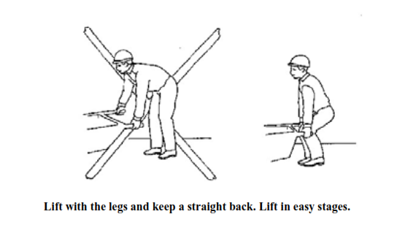

Slide 14
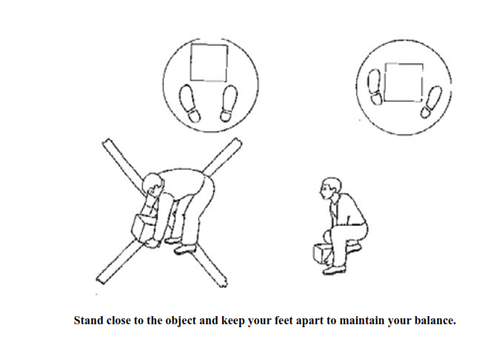

Slide 15
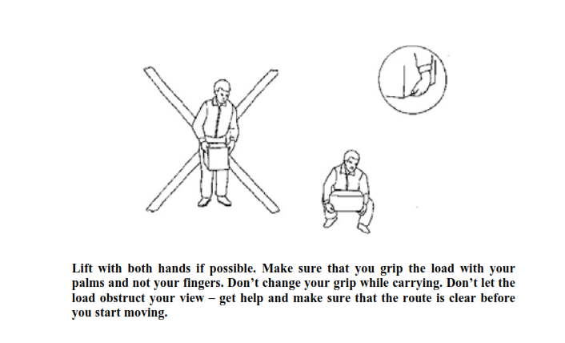

Slide 16
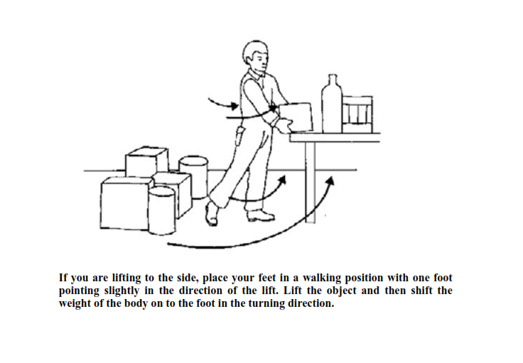

Slide 17
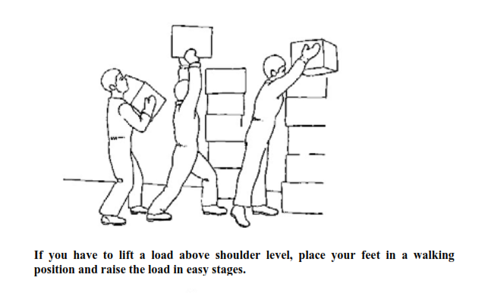

Slide 18
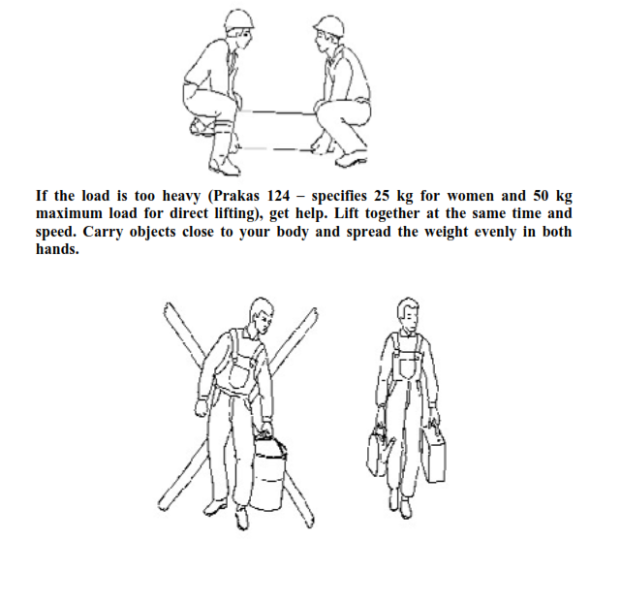

Slide 19
Job Design
Well designed jobs consider the worker’s mental and physical characteristics and tries to minimise the amount of work that is boring, repetitive and lacks stimulation or interest

Slide 20
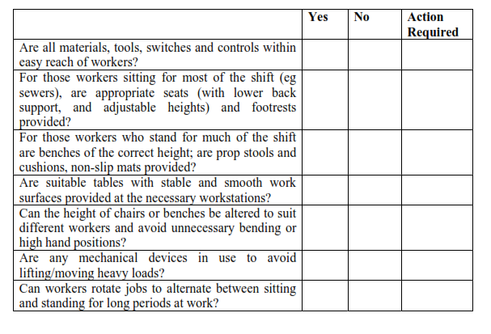
Checklist for workplace design

Slide 21
UNIT V:
Designing the work place, Inventory control, material handling and quality control. Marketing functions, market segmentation, market research and channels of distribution, Sales promotion and product pricing.

Slide 22
Issues in Workstation Design
1. Avoid static loads and fixed work postures
2. Reduce cumulative trauma disorders risks
3. Work height at ~50 mm below elbow
4. Give employee an adjustable chair
5. Use feet as well as hands
6. Use gravity, don't oppose it
7. Conserve momentum
8. Use two-handed motions rather than one-handed
9. Use parallel motions for eye control of two-handed motions
10. Use rowing motions for two-hand motions
11. Pivot motions about the elbow
12. Use the preferred hand
13. Keep arm motions in the normal work area
14. Let the small woman reach; let the large man fit

Slide 23
Goals of Workplace Design and Layout
Maximize performance and minimize hazards:
Minimize postural stress and fatigue (e.g. due to static loading) --- risk factor for work-related injury
Provide reach capability
Anthropometry
Minimize motion times and error rates
Work measurement (e.g. 30% time increase when working overhead)
Provide force capability
strength data and models

Slide 24
Workplace design
Often a major task of ergonomists
Strong relationship between productivity of a workers and their comfort
Primary objective: accommodate the worker
An uncomfortable workplace results in increased energy demands, fatigue, decreased worker performance, and occupational injuries
General considerations
Clearances, reaches, and manipulations (conserve momentum, use gravity when you can)
Visual and auditory demands
Population stereotypes
Standardization, fixed locations, and the total system
Environmental (noise, lighting, temperature, vibration) and organizational factors (such as contact with workers, supervisory control, pacing demands, incentive programs, etc.—can affect mental well being and emotional health)
Posture changes

Slide 25
Workstation Types
Sit
Needed items can be reached, assessed, and handled within the seated workplace.
Items handled are approximately 6” above and 16” in front of the worker
No large forces, no weights greater than 10lbs
Fine assembly, data entry, etc.
Stand
No proper knee clearance
Object weight >10lbs
Frequent high, low, or extended reaches
Frequent movement between stations
Requires downward forces
Optimal height of the hands
Elbow-light assembly, writing, packing
Waist-downward and sideward forces
Sit/Stand
Repetitive operations
Multiple tasks are performed but are of sufficient duration that benefit from sitting
Design in postural flexibility

Slide 26
Workplace Design
Benefits of sitting over standing
Delays the onset of fatigue (weight is taken off the legs, lower energy requirements, lower cardio-respiratory demands, avoid unnatural body postures)
More stability in the task
Allows for the use of foot controls
Pitfalls of prolonged sitting
Negative effects on the curvature of the spine
Disruption of body functions (blood flow, breathing, etc.)
Weakened abdominal muscles
Trade-off considerations
Duration for each tasks, majority of tasks takes precedence
Cater to critical visual tasks (line of sight)
Typically 10-15 degrees below horizontal
Comfort zone identified as somewhere between 15 above and 30 below horizontal
Optimize extended reaches and exertion forces

Slide 27
Adjusting the workplace
Why is it important?
People vary in size and capability, accommodate individual comfort and usability, provides for possibility in changes in posture
How do you do it?
Adjust the workstation
Layout, Location (ht), Orientation
Adjust the person
Chair, Footrests, Armrests
Adjust the work piece
Jigs, clamps, vices
Parts storage bins
Lift tables
Adjust the tools
Design the size, weight, material, use tool balancers

Slide 28
Use preferred hand for reach and grasp motions
Dominant hand is 10% faster for reaching and more accurate.
Dominant hand/arm is about 5-10% stronger
About 10% are left hand dominant.
Preferred hand should be used for dangerous or critical work.
Allow for change-off to non-dominant hand for non-critical work, thus proving rest and recovery.

Slide 29
VDT Workstation Guidelines
Seated posture and chair design
maintaining 'proper' posture through correct use of a good chair
Posture checkpoints to reduce stress of musculoskeletal system
keep elbows close; 90° elbow angle; straight wrist
keyboard slope of 0-25°.
upright head posture; 18-25" from eyes to VDT
line-of-sight 0-60° below horizontal; 20 ° optimal
Vision and Lighting
screen clarity and ambient lighting
glare -> eyestrain
position VDT at 90° to strong light sources
place documents near screen

Slide 30
INTRODUCTION INVENTORY CONTROL
• The term inventory means the value or amount of materials or resource on hand. It includes raw material, work-in-process, finished goods , stores & spares.
• Inventory Control is the process by which inventory is measured and regulated according to predetermined norms such as economic lot size for order or production, safety stock, minimum level, maximum level, order level etc.
• Inventory control pertains primarily to the administration of established policies, systems & procedures in order to reduce the inventory cost.
• Lack of proper attention to the material management in the health system in the country has been a major problem in effective implementation of various health programs.
• Man fails to realize the fact that material represents money and also there is a lack of perception about the inter- relationship between money and the material.
• Non availability of drugs and materials supplies– dissatisfaction among health personnel and also community.
It costs money to hold stocks in terms of storage space, personnel, insurance, security, deterioration and obsolescence.
Higher inventory levels saddle a hospital with avoidable costs. It may be more economical to purchase an item on demand than to maintain an inventory.
At the same time, a certain minimum amount of each item must be held to minimize the chances of total stock-out.
Helps in maintaining an optimum level of all the resources at least possible cost.
Determine appropriate levels of holding inventories, the ordering sequence & the quantities, so that the total costs incurred are minimized.

Slide 31
What is an INVENTORY?
Inventory can be broadly classified as the stock of goods, commodities or other economic resources that are stored or reserved at any given period of time for future production or for meeting future demand.
Stock of materials
Stored capacity
Examples

Slide 32
INVENTORY
Amount of material, a company has in stock at a specific time is known as inventory or in terms of money it can be defined as the total capital investment over all the materials stocked in the company at any specific time.
raw material inventory
in process inventory
finished goods inventory
spare parts inventory
office stationary etc.

Slide 33
Why Inventories?
Protection of industry from the uncertainties in price fluctuations, supply conditions, demand conditions, lead times, transport contingencies etc.
To reduce machine idle times by providing in-process inventories.
To take advantages of quantity discounts, economy of scale in transportation etc.
To decouple operations i.e. to make one operation's supply independent of another's supply.
To reduce the material handling cost of semi-finished products by moving them in large quantities between operations.
To reduce clerical cost associated with order preparation, order procurement etc.

Slide 34
Inventory Costs
Unit cost: it is usually the purchase price of the item under consideration. If unit cost is depends with purchase quantity, it is called as discount price.
Procurement costs: This includes the cost of order preparation, tender placement, cost of postages, telephone costs, receiving costs, set up cost etc.
Carrying costs: This represents the cost of maintaining inventories in the plant. It includes the cost of insurance, security, warehouse rent, taxes, interest on capital engaged, spoilage, breakage etc.
Stockout costs: This represents the cost of loss of demand due to shortage in supplies. This includes cost of loss of profit, loss of customer, loss of goodwill, penalty etc.

Slide 35
Water Tank Analogy for Inventory

Slide 36
OBJECTIVES OF INVENTORY CONTROL
To meet unforeseen future demand due to variation in forecast figures and actual figures.
To average out demand fluctuations due to seasonal or cyclic variations.
To meet the customer requirement timely, effectively, efficiently, smoothly and satisfactorily.
To smoothen the production process.
To reduce loss due to changes in prices of inventory items.
To meet the time lag for transportation of goods.
To meet the technological constraints of production/process.
To balance various costs of inventory such as order cost or set up cost and inventory carrying cost.
To minimize losses due to deterioration, obsolescence, damage, pilferage etc.
To stabilize employment and improve labour relations by inventory of human resources and machine efforts.

Slide 37
BENEFITS OF INVENTORY CONTROL
• Ensures an adequate supply of materials • Minimizes inventory costs & facilitates purchasing economies
• Eliminates duplication in ordering • Better utilization of available stocks • Provides a check against the loss of materials • Facilitates cost accounting activities • Enables management in cost comparison • Locates & disposes inactive & obsolete store items • Consistent & reliable basis for financial statements

Slide 39
Introduction ABC analysis
ABC analysis is important for materials management
It is an inventory categorization technique
Identifying mechanism of impact on the inventory cost
Different management and control techniques required to control products records
Inventories are not equal value and its classified in 3 classes
ABC analysis helps us in using segregating the items from one another and tells us how much valued the items is and controlling it to what extent is in the best interest of the organization.
It has been seen that a large number of items consume only a
small percentage of resources and vice versa.
It is the analysis of stores items on cost criteria.
Expensive items are to be branded as A items.
The in- between items are to be branded as B items.
The least expensive items are to be branded as C items.

Slide 40

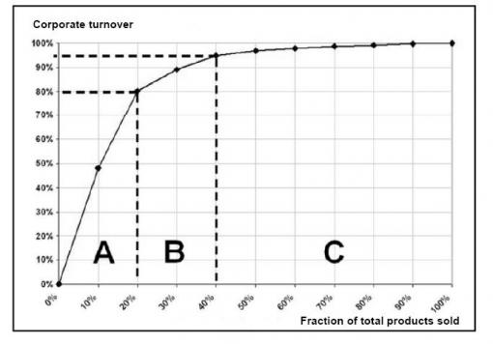
ABC analysis
The ABC analysis is a business term used to define an inventory categorization technique often used in materials management. It is also known as Selective Inventory Control. Policies based on ABC analysis:
A ITEMS: very tight control and accurate records
B ITEMS: Less tightly controlled and good records
C ITEMS: simplest controls possible and minimal records

Slide 42
ABC ANALYSIS OF INVENTORY CONTROL
Also called as PARETO ANALYSIS.
In ABC analysis, the entire lot of inventory is classified into three groups based on
their annual value and not on their individual cost given as- CLASS A- high values items which accounts for major share of annual inventory value.
Stricter control must obviously be applied on these items right from the initial stages of estimating requirement, fixing the minimum stocks, lead time.
A items- Rigorous value analysis. Rigid estimates.
Strict and close watch. Management of items should be done at top level management.
Centralized purchasing and storage.

Slide 43
ABC ANALYSIS OF INVENTORY CONTROL
CLASS B- medium value items, which do not belong to either of the classes and not so strict control procedures , need be followed in regard to the items in this group.
B items- Moderate control. Purchase based on rigid requirements.  Reasonably strict watch and control. Management be done at minimal level.
CLASS C- low values items, but are required in large quantities and consists of various types and varieties like clips, washers.
It needs only a simple and inexpensive system of control in which some of the routine may be existed.
C items- Ordinarily control measures. Purchased based on usage estimates.  Controls exercise by store keeper. Management done at lower levels. Decentralized purchasing.

Slide 44
PROCEDURE OF ABC CLASSIFICATION
Step 1
List down item- wise annual consumption of inventory with unit price and determine the annual consumption of each items.
Step 2
Rewrite the above list in the descending order of money value with additional column to enter cumulative % value.
Step 3
From the list prepared , mark the serial number of items against which the cumulative % value of annual consumption reaches a figure of 70% approximately.
These are called as A items and compute the number of class A items as a percent of total items.
Continue this process down the list and note the serial number of items against which the cumulative % value reads approx. 90% . These additional items constitute class B.
The remaining items in the list from class C items and determines quantity in percent of total number of items.
Step 4
Plot curve with cumulative % of annual usage on quantity items on X- axis and money value on Y- axis.

Slide 45
CONTROL
Class A items are controlled and purchased only on as- required basis to minimize carrying cost.
Higher level control is exercised. These being high value items.
Class C items can be purchased in bulk for the requirement of the entire year, being of low value.
The control is exercised at lower level.
Class B items comes in between A and C on degree of control.

Slide 46
ADVANTAGES
Provides a mechanism for identifying items that will have a significant impact on overall inventory cost.
It helps in economizing ones effort to achieve greater results.
It helps to segregating those items which ought to be given priority to maximize results.
Proper use of valuable time of store personnel.
Simple no confusing formulas are involved.

Slide 47
LIMITATIONS
When number of items run into several thousands, it is not convenient to compute and carry out this analysis.
More chances of deterioration in storage exist since class C are purchased in bulk and inventory on these piles up.
Loose control on C may result in shortage.
ABC focuses on money value and not on functional importance of such items, resulting in shortages of critical items.
ABC does not take into account variation of prices of items as time goes.
ABC ignores market conditions, market availability , competitions, seasonal variations etc.

Slide 48
VED ANALYSIS
In VED method( Vital, Essential, and Desirable), each stock items is classified on either vital, essential or desirable based on how critical the item is for providing health services.
The vital items are stocked in abundance , essential items are stocked in medium amounts and desirable items we socked in small amounts .
Vital and essential items are always in stock which means a minimum disruption in the services offered to the people.

Slide 49
VED METHOD OF INVENTORY CONTROL
In VED analysis, the inventory is classified as per the functional importance under the following three categories:
Vital-
Items without which treatment comes to standstill: i.e. non- availability can not be tolerated.
The vital items are stocked in abundance , essential items and very strict control.
Essential-
Items whose non- availability can be tolerated for 2-3 days, because similar or alternative items are available.
Essential items are stocked in medium amounts, purchase is based on rigid requirements and reasonably strict watch.
Desirable-
Items whose non –availability can be tolerated for a long period.
Desirable items are stocked in small amounts and purchase is based on usage estimates.

Slide 50
PURPOSES OF VED ANALYSIS
In a manufacturing organization, there are number of items which are very vital or critical in production.
Their availability must be ensured at all items for smooth production, so need to be strictly controlled.
Essential items follow vital items in hierarchy of importance.
Desirable items are least importance in terms of functional considerations, which are loosely controlled at the lower level.

Slide 51
MATRIX OF ABC/VED ANALYSIS
There can be combination of these two categories like a matrix combining ABC and VED categories.
This matrix is more relevant in hospitals.
The AV category becomes the most important for inventory control because the items are very much cost consuming being a category and also vital for uses.
These items can be controlled by the top-level management.
The CD category items are not very costly and at the same time of desirable category.
These items are controlled at the lower level.

Slide 52
MATRIX OF ABC/VED

Slide 53
CONTROL OF VED ITEMS
Category Vital items: these items are the most important ones and require control by the administrator himself.
Category Essential items : these items are of intermediate importance and should be under control of the office in charge of the stores.
Category Desirable items : these items are the least importance which can be left under the control of the store keeper.
The grouping will essentially depend upon the strategy of management and the environment of functioning. However these simple techniques can be effective techniques can be effective in material management system.
Items with high criticality (V) , but required in small quantity (A) should receive highest priority. Items with low criticality (D) and which are required in big quantity should receive least priority.

Slide 54
ADVANTAGES OF VED ANALYSIS
It is useful for monitoring and control of stores and spares inventory by classifying them into three categories.
Determine the criticality of an item and its effect on production and other services.
It is useful for controlling and maintain the stock of various types.

Slide 55
EOQ Assumptions
Demand is known and constant
lead time is known and constant
Instantaneous receipt of material
No quantity discounts
Only order (setup) cost and holding cost
No stockouts
Notes:
Students should be asked to consider the degree to which each of these assumptions is accurate.

Slide 56
EOQ Model How Much to Order?
Annual Cost
Total Cost Curve
Minimum total cost
Holding Cost Curve
Order (Setup) Cost Curve
Optimal Order Quantity (Q*)
Order quantity

Slide 57
Material Handling
■ Definition
– The movement, protection, storage and control of material / products throughout the process of manufacture, distribution, consumption and disposal.
■ Objectives – material handling
– Safe
– Efficient & accurate
– Low cost
– Without damage
■ External logistics – outside of facility (rail, truck, air, ship & Pipeline)
■ Internal Logistics – inside of facility (storage, dispatch, inline transport)

Slide 58
Material Handling Equipment
Transport type
To move material from one location to other
Industrial trucks, AGVs, Rail guided vehicles, conveyors, cranes & hoists
Position Equipment
■ Used for single equipment same location(e.g. feeding mechanisms, fixtures,
jaws, turn table)
■ Unit Load Formation Equipment ■ Equipment used to restrict materials so that they maintain their integrity
when handled a single load during transport and for storage.
■ Storage Equipment ■ Equipment used for holding or buffering materials over a period of time.
■ Identification & Control Equipment ■ Barcode, RFID, Magnetic belts, machine visions

Slide 59
Material Handling Equipment

Slide 63
Automated Guided Vehicles

Slide 65
Automatic Storage & Retrieval system
■ Definition
– A combination of equipment and controls which automatically handle, store and retrieve materials with great speed and accuracy, without direct handling by a human worker.
■ Operations performed by AS/RS
– Removal of an item from a storage location automatically
– Transferring the above item to a specific processing or interface point
– After receiving an item from a processing or interface point, it is automatically stored at a predetermined location.

Slide 66
Automatic Storage & Retrieval system

Slide 67
Automatic Storage & Retrieval system
■ Reasons / objective behind implementing Automatic Storage system
– Increasing the storage capacity
– Increasing the stock rotation
– Utilization of maximum floor space
– Recovering the space for manufacturing facilities
– Customer service to be improved
– Control over inventories to be improved
– Ensuring safety in storage function
– Increasing the labour productivity in storage function
– Reducing labour cost in storage operation
– Reducing pilferage and improving security

Slide 68
Types of AS/RS
Unit load AS/RS
– Standard-sized containers
– System is computer controlled.
– Loads are generally over 500 lb per unit.
Mini Load AS/RS
– To handle small loads such as individual parts
– bins or drawers used to store
– Small scale / space available
Deep-Lane AS/RS
– a high-density unit load storage system
– stored in multi deep storage with up to 10 items in a single rack,
Man-on-board AS/RS
Automated Item Retrieval system

Slide 69
Quality
Quality refers to the sum of the attributes or properties that describe a product
These are generally expressed in terms of specific product characteristics such as length, width, colour, specific gravity and the like.
– Performance • Conformity to performance standards
Definition
ASQC – Quality means the totality of features and characteristics of a product or service that bear on its ability to satisfy given needs
From customer’s perspective, quality of a good or service is fitness for use of it
Customer satisfaction for the price of the product

Slide 70
Quality control
• Quality control is a management system for initiating and co ordinating:
– Quality development, quality maintenance and quality improvement in the various departments of design and manufacturing, for achieving the twin objectives of:
Economical production and customer satisfaction
Objectives of Q C
• It is to provide products which are dependable, satisfactory and economical
• To ensure economic production of products of uniform quality acceptable to the customer
• Aims at preventing the defects rather than detecting the defects

Slide 71
Need for quality
• Increased productivity • Reduced cost of repairs • Increases loyal customer base
• Better profits
Quality creation
Those activities involved in the selection of the specific characteristics required to achieve the desired quality and the processing or fabrication of materials to conform to the specific characteristics selected.
Quality creation involves almost all organisational elements of the enterprise and is the basic objective towards which most activity is directed

Slide 72
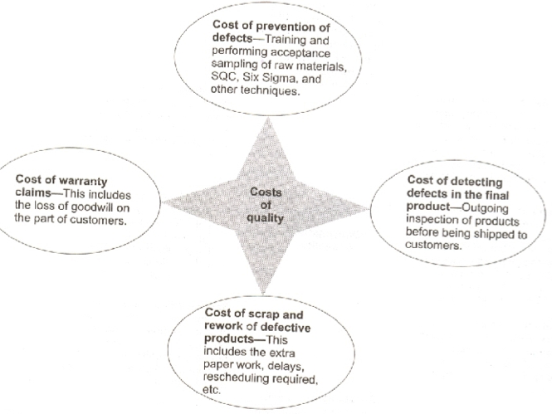

Slide 73
Quality control through Production systems
Inputs – Raw materials – acceptance tests- quality of inputs
Conversion – production processes-control charts- monitoring quality of partially completed products
Outputs- goods & services – acceptance tests- quality of outputs

Slide 74
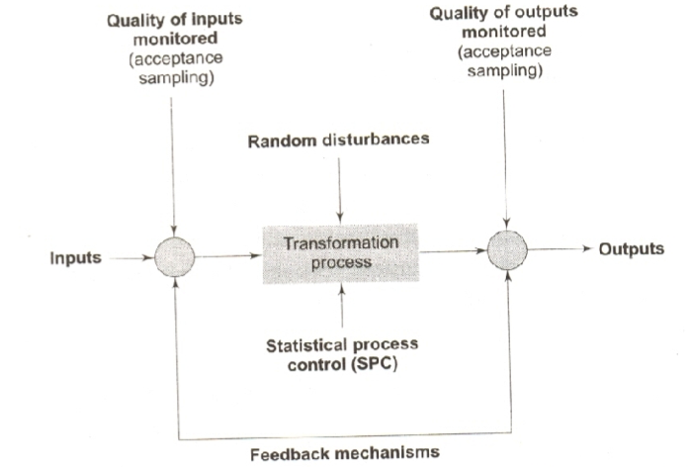

Slide 75
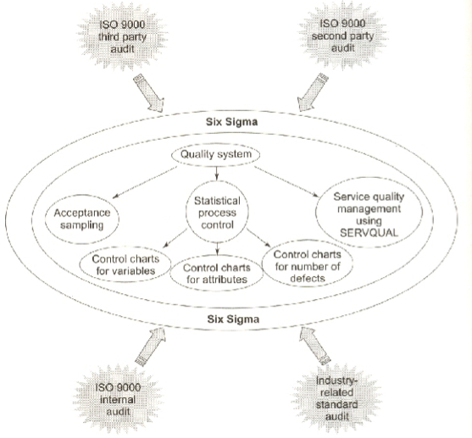

Slide 76
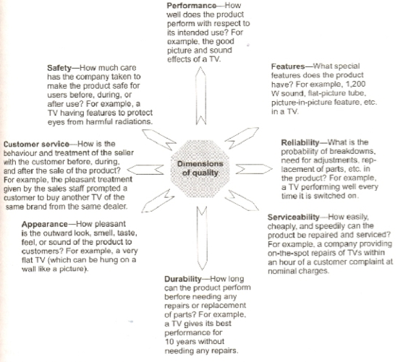

Slide 77
Quality control Techniques
• JIT • Quality at source
• Inspection • SQC • QC • TQM

Slide 78
Just In Time (JIT)
JIT helps achieve quality because it is a philosophy that seeks to constantly improve production processes and methods.
JIT contributes to high product quality in the following ways
– Production is highly standardised. Workers perform standard tasks every day. They are familiar with their tasks. Familiarity ensures high quality
– In process inventories are drastically reduced by cutting lot sizes. Any interruption, therefore causes production to stop until the problem has been solved. In this way, JIT has been called a system of enforced problem solving. Now, this stoppage in production forces everybody to solve the quality problem so that the defect will not repeat. Hence high product quality is ensured.
– Suppliers of materials, under JIT system, supply materials of perfect quality. Many companies do not even inspect suppliers’ deliveries of materials; rather, the emphasis is on working with suppliers to produce perfect parts and materials.
– JIT system envisages the use of automated equipment and robots in production processes. Use of such sophisticated machines will ensure high product quality.
– JIT system also envisages the use of intensive preventive maintenance programmes in order to prevent any machine breakdown. This results in machines producing parts of perfect quality.
– Workers are responsible for producing parts of perfect quality or with zero defects before they are passed on to the next production operation.

Slide 79
Quality at the source
• The worker is put in the driver’s seat in controlling product quality. The principles underlying quality at the source are:
– Every worker’s job becomes a quality control station. The worker is responsible for inspecting his own work, identifying any defects and reworking them in to non- defectives, and correcting any causes of defect.
– Statistical quality control techniques are used to monitor the quality of parts produced at each work station/ and easy-to-understand charts and graphs are used to communicate progress to workers and managers .
– Each worker is given the right to stop the production line to avoid producing defective parts
– Workers and managers are organised into quality circles- groupes of people who analyse quality problems, work to solve the problems, and implement programmes to improve product quality.

